Slide 1
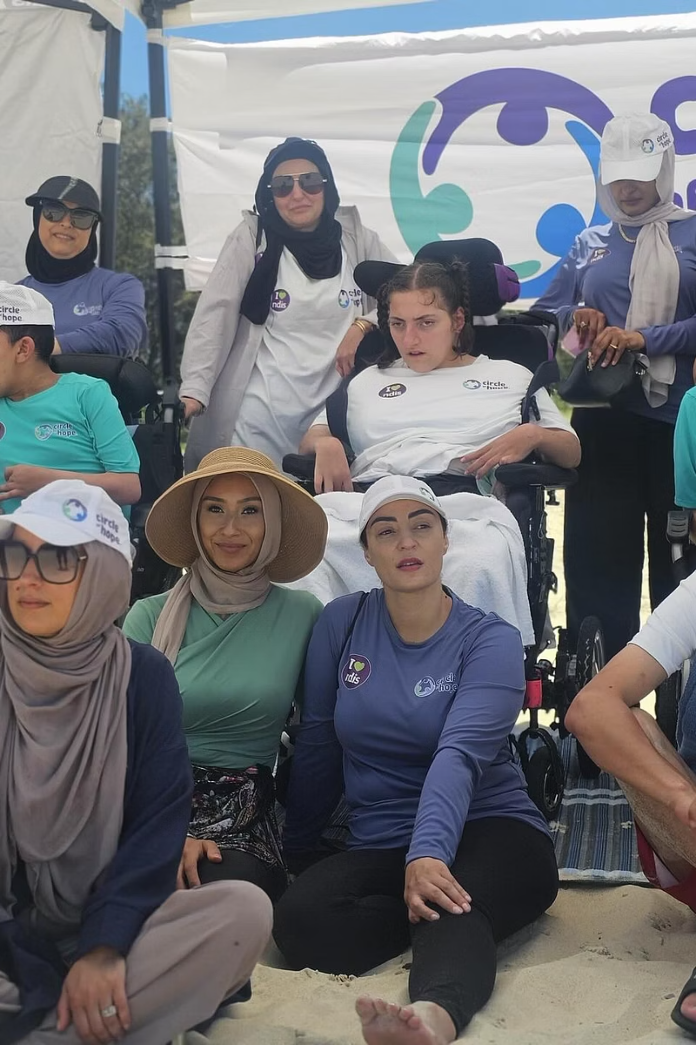

Disability Service Providers East Hills: Helping You Live Your Life Your Way
Finding the right support can make a world of difference in your journey toward independence and fulfillment. In East Hills, a vibrant community of disability service providers is dedicated to helping you access personalized care that matches your unique needs, goals, and lifestyle. Whether you're navigating the NDIS for the first time or seeking a provider who truly understands what matters most to you, East Hills offers trusted local expertise combined with compassionate, person-centered support that empowers you to live life on your own terms.

Slide 2
Circle of Hope: Personalized Support for Independence
Why Choose Circle of Hope?
Comprehensive Service Offerings
As a trusted NDIS Registered Provider in East Hills, Circle of Hope delivers comprehensive support services designed around your individual journey. Their experienced team understands that independence looks different for everyone, and they're committed to helping you achieve your personal vision of freedom and wellbeing.
Personal care assistance tailored to your daily routines and preferences
Occupational therapy to develop skills and adapt your environment
Speech pathology services for communication and swallowing support
Physiotherapy to improve mobility, strength, and physical function
Community participation programs connecting you to social activities
Daily living assistance from cooking to household management
Circle of Hope creates tailored care plans that focus on building your independence, confidence, and overall wellbeing. Their services range from hands-on daily assistance to therapeutic supports and community engagement opportunities—all designed around your specific goals. With transparent communication and a commitment to understanding your unique story, Circle of Hope ensures you receive exactly the support you need without unnecessary complications.

Slide 3
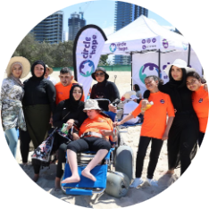
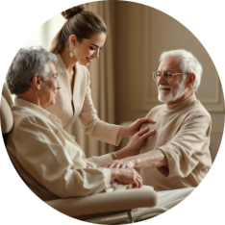
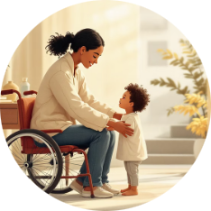

Disability Services Australia & The Disability Trust: Comprehensive & Inclusive Care
Disability Services Australia
The Disability Trust
Disability Services Australia operates multiple outlets throughout the region, including East Hills, offering an extensive range of supports designed to empower participants. Their comprehensive service model covers daily living assistance, therapeutic interventions, community participation programs, employment support, and plan management services. With a focus on practical, personalized care, they help individuals access the full spectrum of NDIS supports while building skills, confidence, and independence in everyday life.
As one of Australia's leading disability service organizations, The Disability Trust employs over 3,000 dedicated staff members supporting more than 6,000 clients across the country. Their commitment to inclusion, choice, and high-quality personalized support sets them apart. The organization emphasizes empowering people to live, work, and belong in their communities through innovative programs, skilled professionals, and a genuine dedication to understanding each participant's unique aspirations and needs.
Daily Living Support
Therapeutic Services
Community Participation
Employment Pathways
Assistance with cooking, cleaning, personal care, and household tasks
Access to occupational therapy, physiotherapy, and speech pathology
Join social activities, build friendships, and engage with your community
Guidance for work readiness, training, and developing career skills

Slide 4





Your Life, Your Way: Empowerment Through Choice and Support
East Hills disability service providers share a common mission: putting you at the center of your own story. Their person-centered approach ensures that every service, every interaction, and every support plan is tailored to your individual aspirations, preferences, and goals. Whether you need assistance with daily tasks, therapeutic intervention, or community connection, these providers champion your autonomy, dignity, and right to meaningful inclusion.
Your Goals Drive Everything
Trusted Local Expertise
Pathways to Independence
Services designed around what matters to you
Experienced teams who understand the East Hills community
Building skills, confidence, and autonomy every day
From therapy and plan management to supported living and community engagement, East Hills providers create comprehensive pathways for people with disabilities to live fulfilling, independent lives—on their own terms.
Together, Circle of Hope, BEHHA, Disability Services Australia, and The Disability Trust form a network of excellence in East Hills. They combine local knowledge with professional expertise, transparent communication with compassionate care, and innovative services with time-tested values. The result? A community where people with disabilities have genuine choice, real support, and unlimited potential to thrive.

