Slide 1


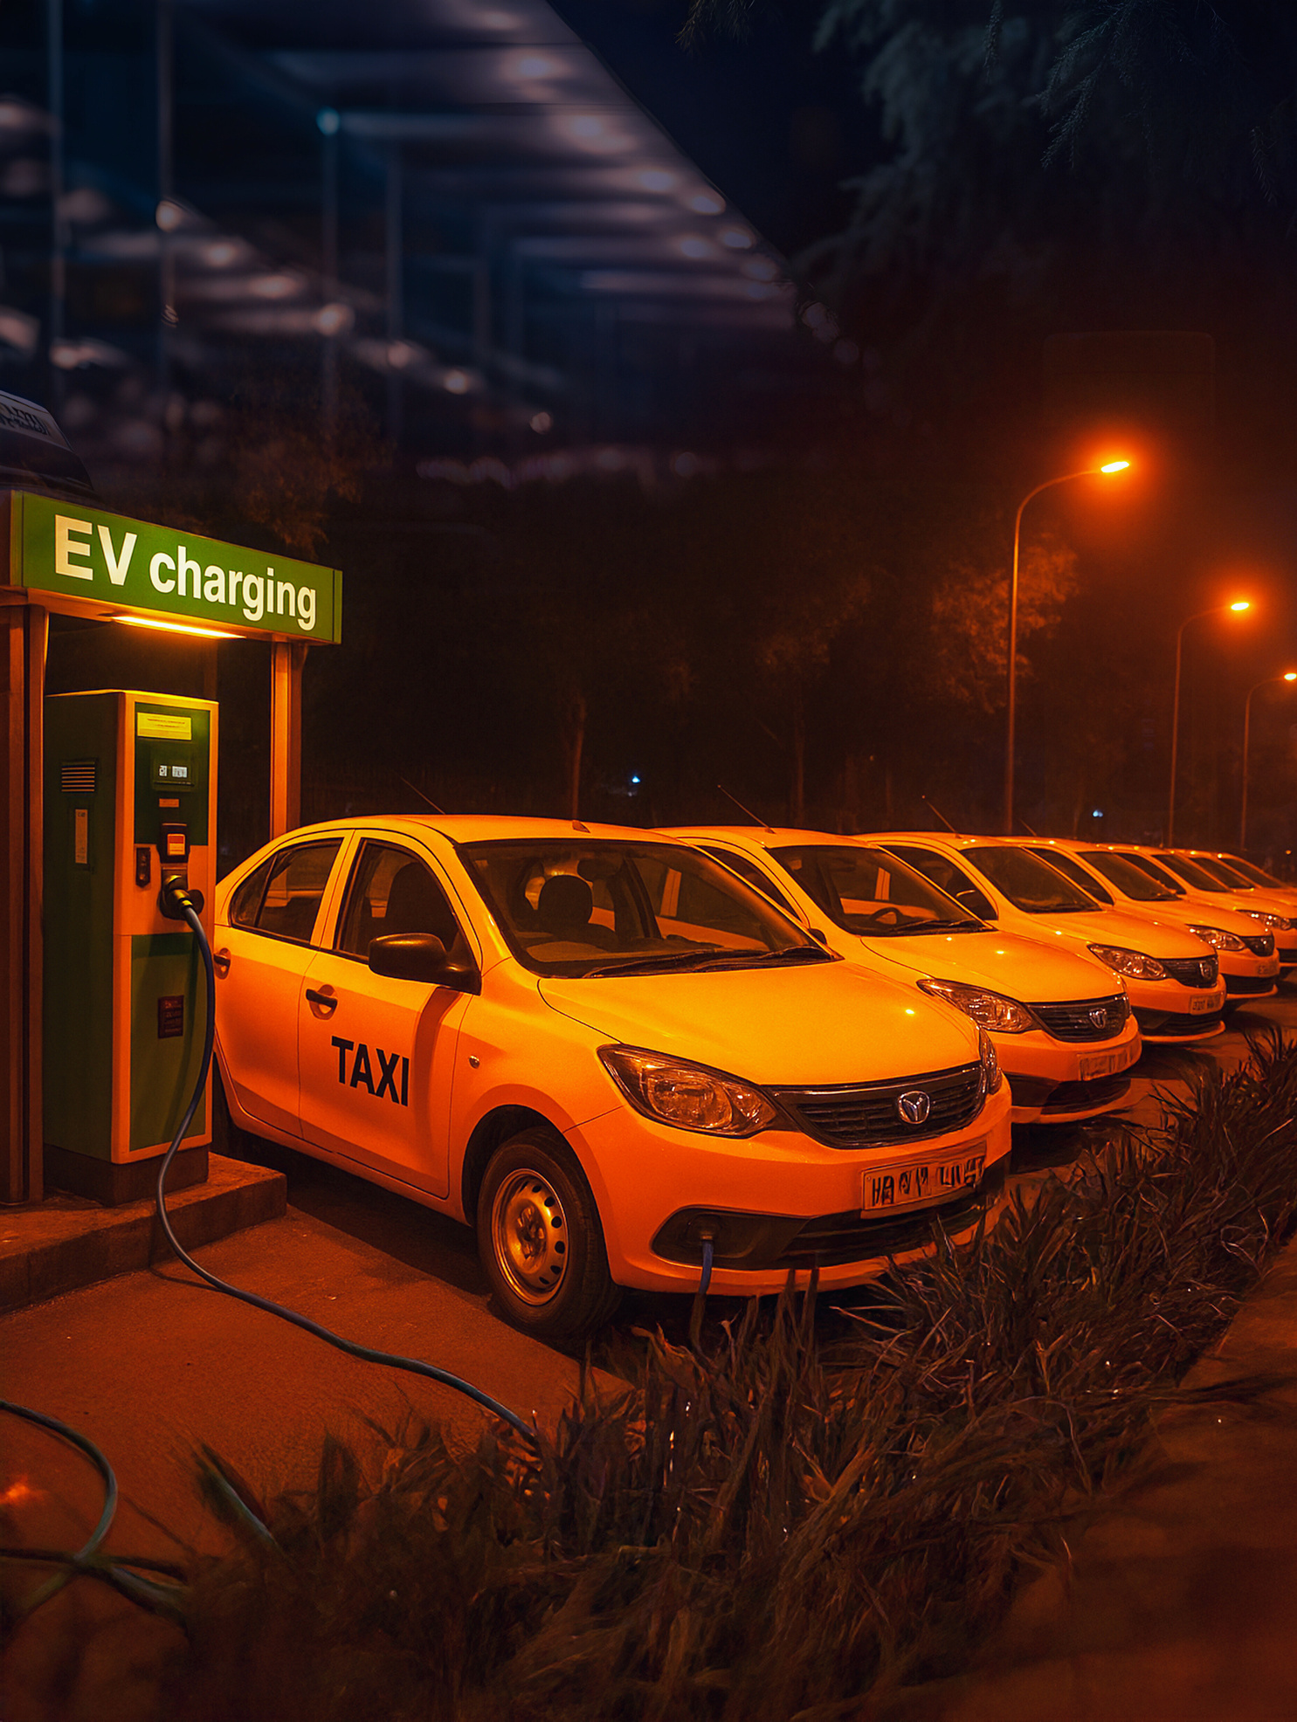




Are Commercial EV Loans in India Getting Cheaper in 2025?

Slide 2




Why this matters for fleet operators?
Fleets scaling (2W/3W/4W/
commercial trucks) need access to affordable capital
EVs already reduce fuel + maintenance costs; cheaper loans amplify savings
Lowering loan rates = better cash flow and
more profits

Slide 3





Where it’s not cheaper (yet)?
Two-wheeler EV loans still carry higher interest rates (~ 18-22%) owing to battery life/resale risk concerns.
For some banks, the discount over ICE loans is slim (~ 5-25 basis points) for cars/SUVs.
Processing fees, loan-to-value, and pre-payment charges often reduce the benefit.

Slide 4









Key drivers pushing loan costs down
RBI repo rate reductions & lower benchmark lending rates.
Policy incentives: lower GST, tax & registration fee waivers, subsidies for EVs.
Competition among banks & NBFCs is trying to increase EV portfolios.
Digital & green-loan schemes simplifying documents & lowering the operating cost of financing.

Slide 5

What fleet-focused operators should watch
1
Terms for loan tenure & loan amount (LTV), longer tenures reduce EMIs
2
Hidden costs: processing fees, prepayment/foreclosure penalties
3
Vehicle type & battery guarantee (affects lender’s risk profile)
4
Verify if the lender supports refurbished EVs or only new ones
5
Check if green financing/incentives are passed through fully

Slide 6

The Revfin Perspective
1
Revfin offers commercial EV loan packages that prioritize minimal documentation, faster approvals, and financing for new and refurbished EVs
2
For fleet operators, this means you can tap into cheaper effective loan costs sooner
3
Using added features like IoT monitoring & support for new-to-credit borrowers helps manage risk.

Slide 7
Summary & Forecast
Yes, in many cases, commercial EV loans are getting cheaper in 2025, especially for 4W, LCVs, cars, but not universally (2W still lagging)
Expect continued moderation of rates as policy & competition intensify
Fleets that move early and choose lenders who absorb incentives + offer flexible terms will benefit the most

Slide 8

Recommendations for Fleet Owners
Compare lenders: ask about EV vs ICE loan rates, not just advertised rates
Explore refurbished EV financing if the upfront cost is a blocker
Negotiate for green incentives or OEM tie-ups
Ensure documentation, battery warranties, and post-loan support are in place

Slide 9






Want better commercial EV loan options?
Contact Revfin today, they specialise in commercial electric vehicle loans with minimal paperwork, OEM partnerships, support for new-to-credit operators, and refurbished vehicle options.
fleet.mobility@revfin.in or www.revfin.in

