Slide 1
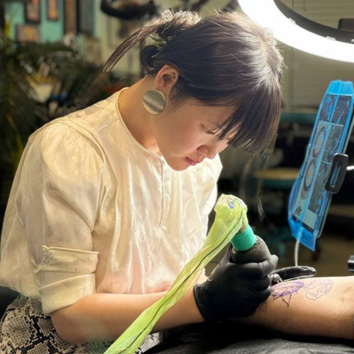
Welcome to Mantra Tattoo
Affordable Tattoo & Piercing Service

Slide 2
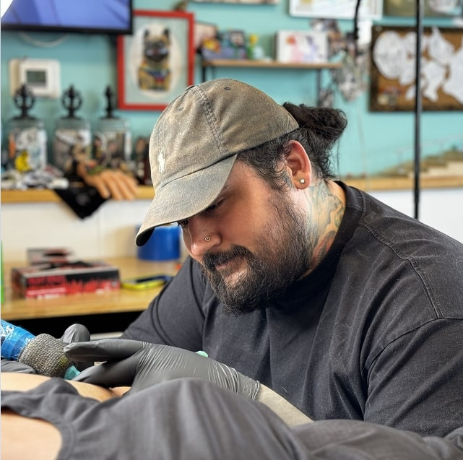
Company Overview
Mantra Tattoo & Piercing is Colorado’s best premiere full service tattoo shop providing professional clean custom tattoos, piercings, and a large variety of jewelry and clothing. Whether you’re looking to get a giant backpiece or something small and special behind your ear, our artists are thrilled to help you get the tattoo you really want.
Visit the best tattoo shop offering creative, safe, and professional tattoos.

Slide 3


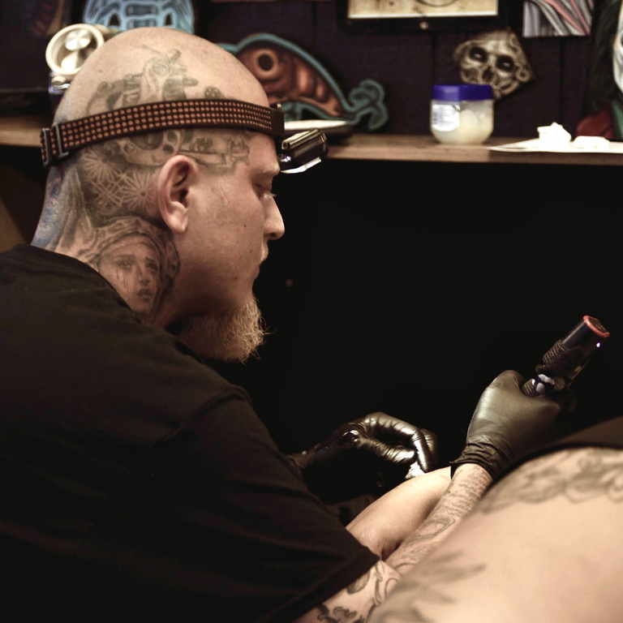

Services
Overview
Mantra Tattoo is a premier tattoo studio known for its artistic excellence and commitment to delivering unique, personalized tattoo experiences. With a team of skilled artists, we specialize in a wide range of tattoo styles, from intricate designs to bold, vibrant artwork. At Mantra Tattoo, we prioritize creativity, hygiene, and customer satisfaction, ensuring each client receives a tattoo that reflects their individuality. Whether it's your first tattoo or your latest piece, we aim to create an unforgettable experience and a masterpiece that lasts a lifetime. Visit us today and let your tattoo journey begin!
Our shop is open 7 days a week. Call us or come by to check out the shop and talk to our artists.

Slide 4
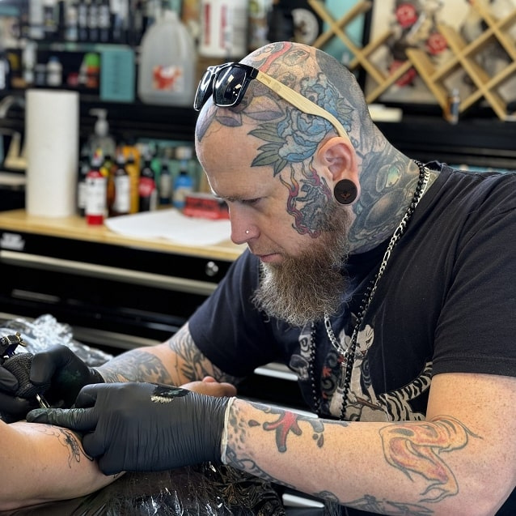

Visit the best tattoo shop offering creative, safe, and professional tattoos.
At the Best Tattoo Shop, we believe every tattoo tells a story. Let our expert artists craft a design that speaks to your individuality. With years of experience and a focus on quality, we guarantee stunning results in a safe and friendly setting. Walk-ins welcome!

Slide 5







Contact Us
Web
www.mantratattoo.us
Address
1695 Wadsworth Boulevard, Lakewood, Colorado, United States
Phone
(303) 239-8282 / (720) 639-6333
Email
mantra303media@gmail.com

Slide 6




Thank you for
your attention

