Slide 1

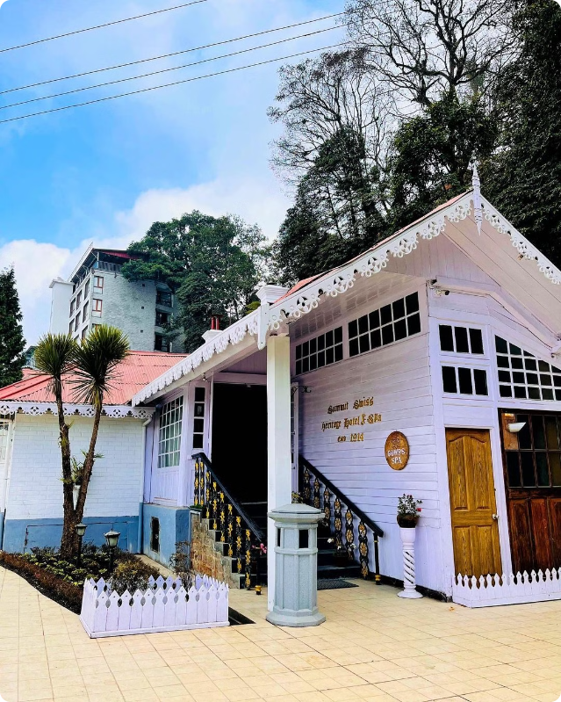
Convenient Stay at Hotels in Darjeeling Near Mall Road
Darjeeling is a beautiful hill station in West Bengal, India. Known for its stunning views of the Himalayas and tea plantations, Darjeeling is a popular tourist destination. Make your Darjeeling hotel booking simple and hassle-free at Summit Swiss Heritage Resort & Spa. Enjoy a blend of comfort and luxury with our well-appointed rooms and top-notch amenities.

Slide 2
Best Hotels in Darjeeling Near Mall Road
Summit Swiss Heritage Resort & Spa, Darjeeling
Stay at Summit Swiss Heritage Resort & Spa, one of the best hotels in Darjeeling. Our hotel offers stunning views, luxurious rooms, and exceptional service to make your stay memorable. Whether you're here for leisure or business, we provide the perfect setting. Conveniently located near Mall Road, explore the beauty of Darjeeling with ease.

Slide 3
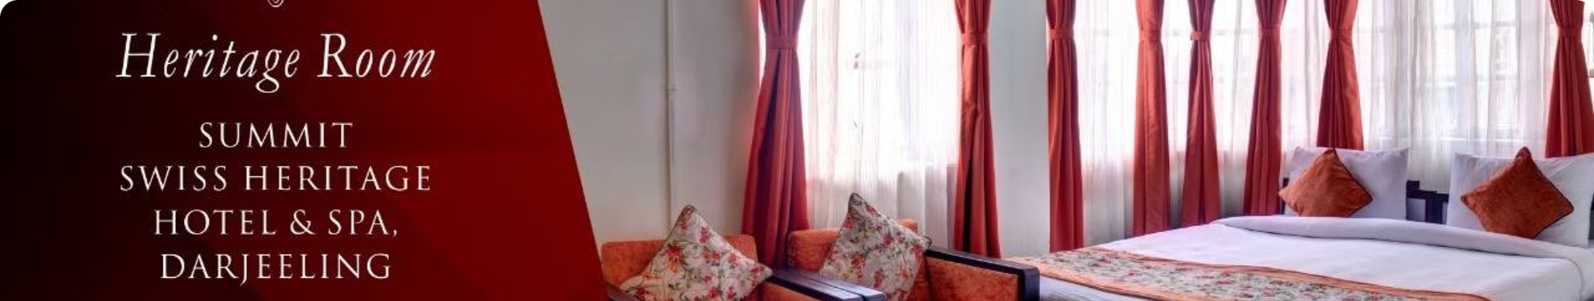
Best Hotels and Resorts in Darjeeling
5 Star Hotels in Darjeeling
Darjeeling Mall Road Hotels
Budget Hotels in Darjeeling
Summit Swiss Heritage Resort & Spa offers luxurious rooms and suites with stunning views of the Himalayas. Our 5 star hotels in Darjeeling ensure a comfortable and memorable stay.
Our resort is conveniently located near Mall Road, making it easy for guests to explore the vibrant local scene. Enjoy shopping, dining, and sightseeing just steps away from your accommodation.
We offer a range of accommodations to fit different budgets, ensuring that everyone can experience the luxury of Summit Swiss Heritage Resort & Spa without breaking the bank.

Slide 4
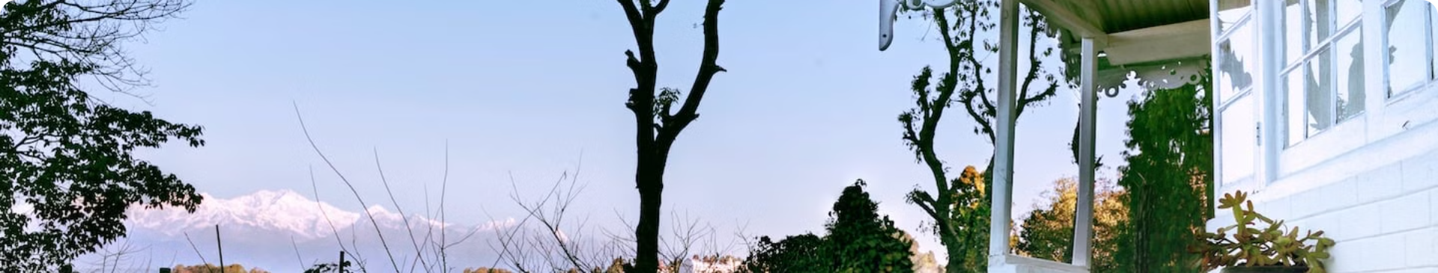
Amenities to Enhance Your Stay
1
Outdoor Pools
2
Spa and Wellness Centers
Enjoy a refreshing dip in the pool while enjoying the breathtaking mountain views.
Indulge in rejuvenating spa treatments and wellness services to enhance your experience.
3
Fine Dining Restaurants
4
Fitness Centers
Explore a range of culinary options, from local delicacies to international cuisines.
Stay active during your stay with state-of-the-art fitness centers, offering a variety of equipment.

Slide 5
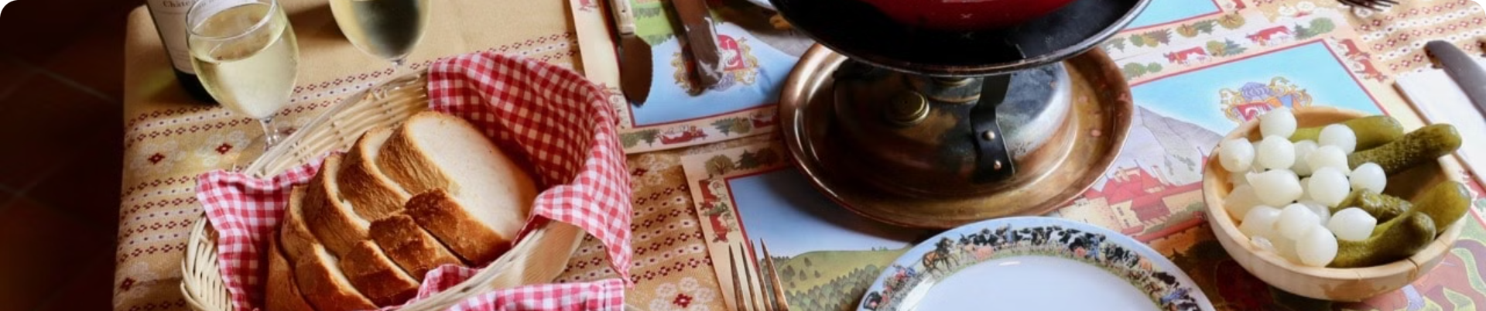
Dining Options: Local and International Cuisine
Local Cuisine
International Cuisine
Momos
Italian
Thukpa
Chinese
Gundruk
Continental

Slide 6

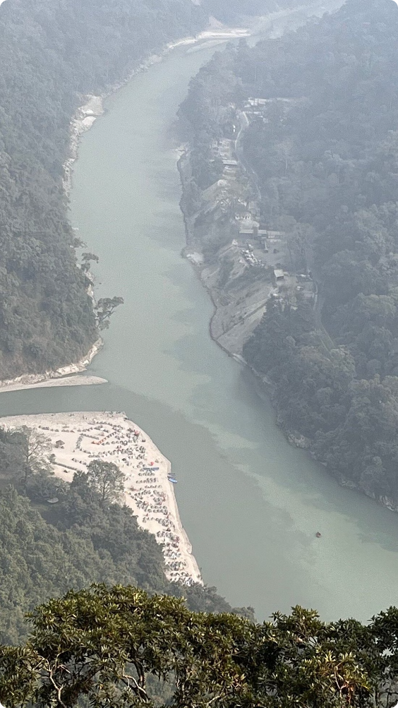
Exploring Darjeeling's Rich Culture and Heritage - 5 star Hotels in Darjeeling
1
Tibetan Buddhist Culture
Explore the vibrant Tibetan Buddhist culture through monasteries, prayer wheels, and traditional art.
2
Tea Plantations
Visit tea plantations and learn about the history and process of Darjeeling's renowned tea production.
3
Colonial History
Discover the rich colonial history of Darjeeling through its architectural landmarks and historical sites.

Slide 7

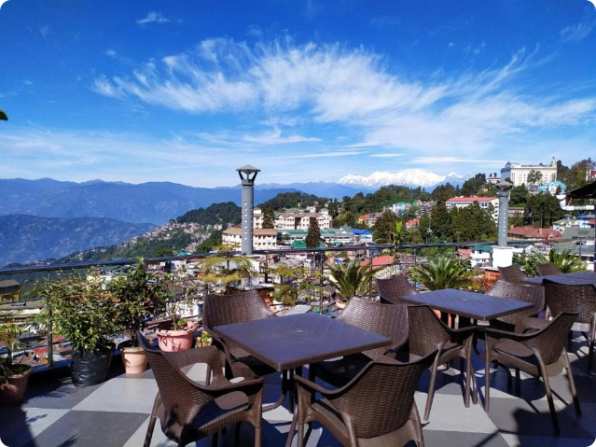

Booking and Reservation
Information
Contact us:
Address- 15/9A, Gandhi Rd., near Circuit House, Limbugaon, Darjeeling, West Bengal, 734101
GMB link - https://maps.app.goo.gl/xKBCn3RmWLUPA6kS8
Contact no.- 8388877888

